Slide 1

Web Development with React and .NET core

Slide 2
Main Module
HTML & CSS Fundamentals
JavaScript
React
ASP .Net
MSSQL
ASP .NET APIs

Slide 3
Setting Up
IDE : VS Code
Browsers : Chrome & Firefox
Notes:
https://code.visualstudio.com/download
https://chrome.google.com/webstore/detail/web-server-for-chrome/ofhbbkphhbklhfoeikjpcbhemlocgigb/related

Slide 4
HTML & CSS Fundamental

Slide 5
What is HTML?
HTML stands for Hyper Text Markup Language
HTML is the standard markup language for creating Web pages.
HTML describes the structure of a Web page.
Notes:
စာသားတွေကို သုံးပြီး UI တခုဖြစ်အောင်ဖန်တီးနိုင်တဲ့ Markup language

Slide 6
HTML Document Structure
<!doctype html> <html> <head> <title></title> </head> <body> </body> </html>
-

Slide 7
<head></head>
<title></title>
<meta></meta>
<link>
<script></script>
Example
<meta charset="UTF-8">
<meta name="viewport" content="width=device-width, initial-scale=1.0">
<title>My Website</title>
<link rel="stylesheet" href="styles.css">
<script src="script.js"></script>

Slide 8
<body></body>
<!DOCTYPE html>
<html>
<head>
<meta charset="UTF-8">
<title>My Website</title>
<link rel="stylesheet" href="styles.css">
<script src="script.js"></script>
</head>
<body>
<h1>Welcome to My Website</h1>
<p>This is the content of my web page.</p>
</body>
</html>

Slide 9
Hello World!
<!doctype html> <html> <head> <title>My Webpage</title> </head> <body> <h1>Hello World!</h1> </body> </html>

Slide 10
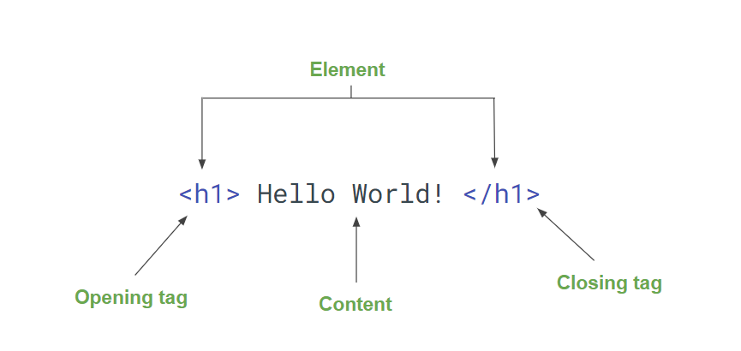
HTML Elements

Slide 11
HTML Tags and Attributes
Text Formatting Tags
Structural tags:
Heading tags:
Hyperlink tags:
Media tags:
Semantic HTML Tags:

Slide 12

Important HTML Elements
Block Element
<div></div>
<p></p>
<h1>to <h6>
<ul><ol><li>
<form>
<table>
<section>
<nav>
Inline Element
<span></span>
<a></a>
<strong></strong>
<img>
<input>
.. etc
Notes:
Inline elements တွေထဲမှာ Data တွေနဲ့ အခြား Inline elements ေတွပဲ ပါရမယ်
Block elements တွေကို inline elements တွေထဲကို မထည့်ရဘူး။

Slide 13
HTML Attributes
provide additional information about HTML elements
Attribute တွေမှာ Name နဲ့ value အတွဲလိုက်ပါတယ်
eg. id=”intro”
<div id="intro“> <h1 class=“highlight box">Introduction</h1> </div>
<a href="https://www.example.com" class="btn">Click me</a>
<img src="image.jpg" alt="Description of the image">
Notes:
Class က အဖွဲ့အစည်းတခ, multiple class ပေးလို့ရတယ်

Slide 14
Question အောက်ပါ Element များမှ Block-level Elements များကို ရွေးပါ။
<form>
<input>
<strong>
<header>
<span>
<div>
Notes:
Form, header, div

Slide 15
Hyperlink
<a href="https://www.example.com">Visit Example.com</a>
<a href="/about.html">About Us</a>
<a href="https://www.example.com" target="_blank">Visit Example.com</a>
<a href="https://www.example.com" rel="nofollow">Visit Example.com</a>
Notes:
<img
srcset="elva-fairy-480w.jpg 480w, elva-fairy-800w.jpg 800w"
sizes="(max-width: 600px) 480px,
800px"
src="elva-fairy-800w.jpg"
alt="Elva dressed as a fairy" />
Pixel density radio

Slide 16
Images
src
<img src="image.jpg" alt=“name of the image">
srcset
<img srcset="image-1x.jpg 1x, image-2x.jpg 2x" alt="An image">
Notes:
<img
srcset="elva-fairy-480w.jpg 480w, elva-fairy-800w.jpg 800w"
sizes="(max-width: 600px) 480px,
800px"
src="elva-fairy-800w.jpg"
alt="Elva dressed as a fairy" />
Pixel density radio

Slide 17
Figure
<figure> <img src="https://placekitten.com/320/300" alt="Kitty Image"> <figcaption>Responsive Kitty Image Here</figcaption> </figure>

Slide 18
Exercies
Create an responsive image
Create an image with alt tag
Create an image tag which will change the image on different screen sizes
Wrap it with figure tag and add figcaption

Slide 19
Semantics Layout
<header> <h1>Header</h1> </header> <nav> <ul> <li><a href="#">Menu Option 1</a></li> <li><a href="#">Menu Option 2</a></li> </ul> </nav> <section> <article> <header> <h1>Article #1</h1> </header> <section> This is the first article. </section> </article> </section> <footer>Footer</footer>
Header
Navigation
Article
Section
Footer
Notes:
Inline elements တွေထဲမှာ Data တွေနဲ့ အခြား Inline elements ေတွပဲ ပါရမယ်
Block elements တွေကို inline elements တွေထဲကို မထည့်ရဘူး။

Slide 20
Form & Inputs
<form action="" method="get"> <label for="name">Enter your name: </label> <input type="text" name="name" id="name" required> <label for="password">Enter your password: </label> <input type="password" name="password" id="password" required> <input type="submit" value="Login!"> </form>
action
autocomplete
method
target

Slide 21
Input Types
Attributes :
autocomplete
disabled
name
readonly
required
tabindex
type
value
Placeholder
……..
<input type="text">
email
password
button
submit
file
radio
checkbox
date
hidden
search
....

Slide 22
Other Input Types
<textarea> <select> <option>Option</option> </select> <button>Button</button>

Slide 23
Question Lable တစ်ခုရဲ့ for Attribute က
value တူတဲ့ id attribute ပါတဲ့ element ကို target ထားဖိုသုံးတယ်။
value တူတဲ့ name attribute ပါတဲ့ element ကို target ထားဖို သုံးတယ်။
Notes:
a

Slide 24
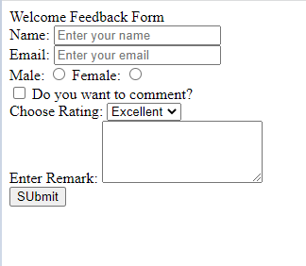
Exercise Create a feedback form
Notes:
a

Slide 25
Table
<table> <thead> <tr> <th>The table header 1</th>
<th>The table header 2</th> </tr> </thead> <tbody> <tr> <td>The table body</td> <td>with two columns</td> </tr> </tbody> </table>
** Do not use this in any layouting
** Most attributes of the table are deprecated already
Notes:
Inline elements တွေထဲမှာ Data တွေနဲ့ အခြား Inline elements ေတွပဲ ပါရမယ်
Block elements တွေကို inline elements တွေထဲကို မထည့်ရဘူး။

Slide 26
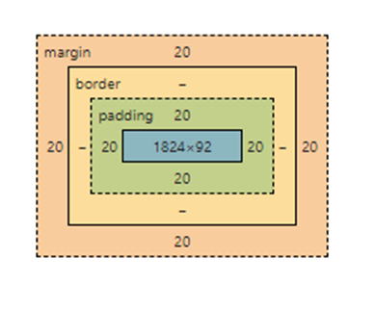
Using the HTML Style Attribute
<!DOCTYPE html>
<html>
<head>
<meta charset="UTF-8">
<meta name="viewport" content="width=device-width, initial-scale=1.0">
<meta name="description" content="Description of your web page">
<title>Your Page Title</title>
</head>
<body>
<h1 style="text-align: center; font-size: 20px;">This heading is centered.</h1>
<div style="background-color: blue; margin: 20px; padding: 20px;">
<p style="font-family: Arial, sans-serif; background-color:bisque; color: black; border: 1px yellow solid; padding: 20px;">This text has Arial font family.</p>
</div>
</body>
</html>
Usage
<tag style="property: value;">
E.g. font-size, text-align, padding, margin,…
Notes:
Inline elements တွေထဲမှာ Data တွေနဲ့ အခြား Inline elements ေတွပဲ ပါရမယ်
Block elements တွေကို inline elements တွေထဲကို မထည့်ရဘူး။

Slide 27
Exercise
Create a login form
Frame it with table
Include username, password and a submit button
Required field validation for both username and password
User will redirected to google.com on submit

